Slide 1
Tunability Analysis
Wojciech Kosiuk | Michał Mazuryk

Slide 2
Agenda
01
02
Datasets
03
Random Search
Bayes Optimization
Default Configurations
04

Slide 3
01
Datasets

Slide 4


Datasets
SPECT heart data - diagnosis
Bank customers – closed account
Bank marketing – buying a product
Eye measurement – movement of the eye

Slide 5
02
Default Configurations

Slide 6
Grid Search
Highest mean AUC across 4 Datasets :
Notes:
Opisać 3 zakładki i tyle, speeeed

Slide 7
Grid Search
Highest mean AUC across 4 Datasets :
i = 1,2,3,4
Param Set 1 Score = mean(AUC_{param1_i})
Notes:
Opisać 3 zakładki i tyle, speeeed

Slide 8
Grid Search
Highest mean AUC across 4 Datasets :
i = 1,2,3,4
Param Set 1 Score = mean(AUC_{param1_i})
Param Set 2 Score = mean(AUC_{param2_i})
Notes:
Opisać 3 zakładki i tyle, speeeed

Slide 9
Grid Search
Highest mean AUC across 4 Datasets :
i = 1,2,3,4
Param Set 1 Score = mean(AUC_{param1_i})
Param Set 2 Score = mean(AUC_{param2_i})
Param Set 3 Score = mean(AUC_{param3_i})
…...
Notes:
Opisać 3 zakładki i tyle, speeeed

Slide 10
Grid Search
Random Forest:
n_estimators: [50, 100, 200]
max_depth: [5, 10, 20]
min_samples_split: [2, 5, 10]
min_samples_leaf: [2, 5, 8]
Notes:
Opisać 3 zakładki i tyle, speeeed

Slide 11
Grid Search
XGBoost:
n_estimators: [50, 100, 200]
max_depth: [3, 5, 7, 10]
learning_rate: [0.001, 0.005, 0.01, 0.02]
Notes:
Opisać 3 zakładki i tyle, speeeed

Slide 12
Grid Search
LightGBM:
n_estimators: [20, 100, 300]
max_depth: [3, 7, 10]
learning_rate: [0.01, 0.1, 0.3]
num_leaves: [10, 31, 65, 100]
Notes:
Opisać 3 zakładki i tyle, speeeed

Slide 13
03
Random Search

Slide 14
Random Forest
Highest mean AUC for each dataset across 3 seeds:
S = 1,2,3
Dataset 1 Score = mean(max(AUC_{1_s}))
Dataset 2 Score = mean(max(AUC2_s))
Dataset 3 Score = mean(max(AUC3_s))
Dataset 4 Score = mean(max(AUC4_s))
Notes:
Opisać 3 zakładki i tyle, speeeed

Slide 15
Random Forest
Hyperparameters range:
n_estimators: (50, 200)
max_depth: (5, 20)
min_samples_split: (2, 10)
min_samples_leaf: (2, 8)
Notes:
Szybko

Slide 16
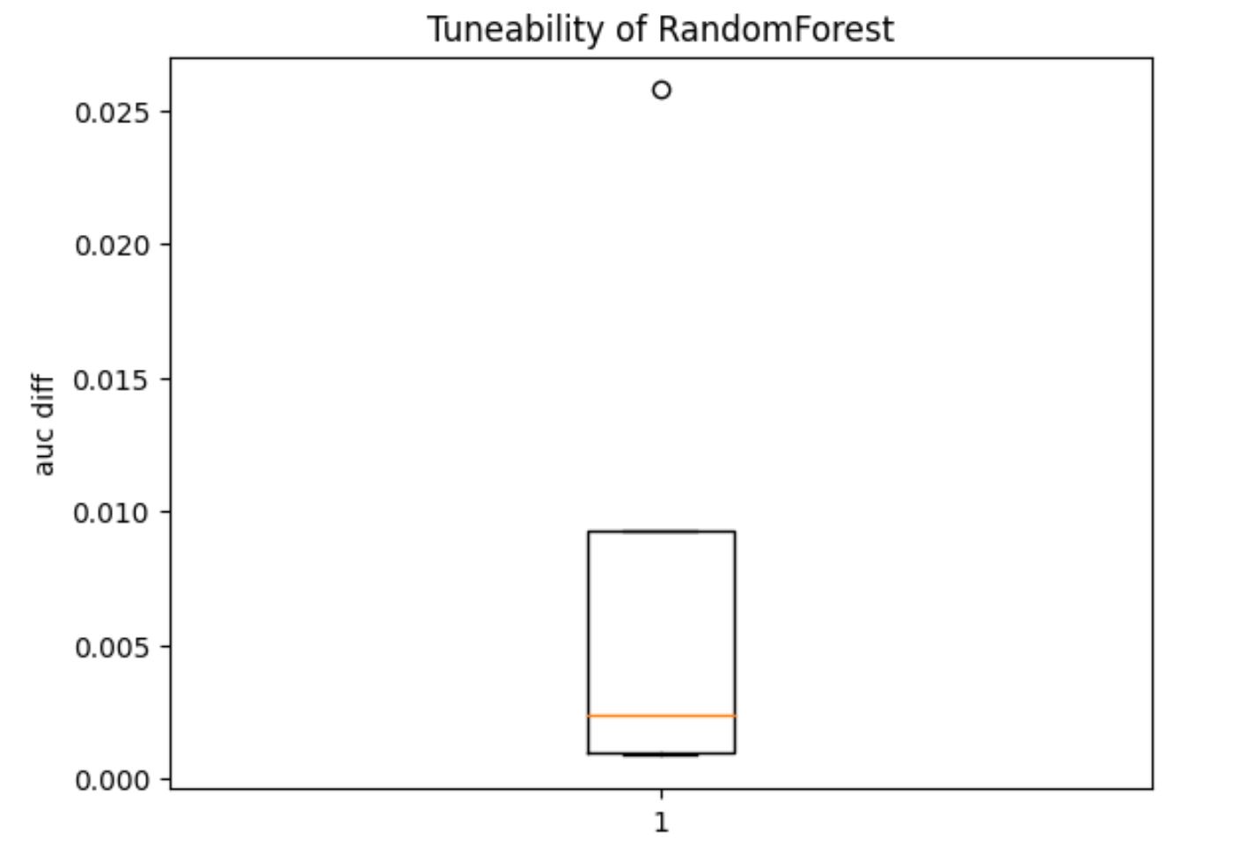
Random Forest
Algorithm Tunability:
Notes:
Szybko

Slide 17
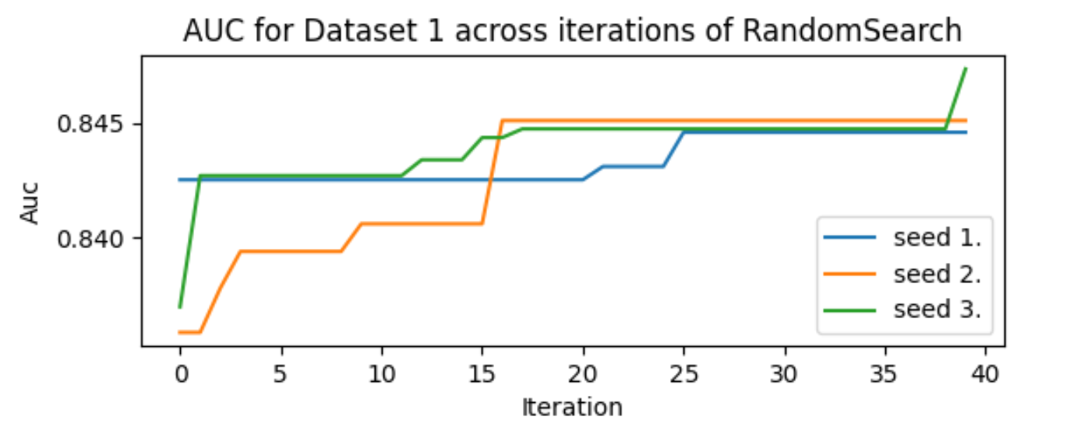
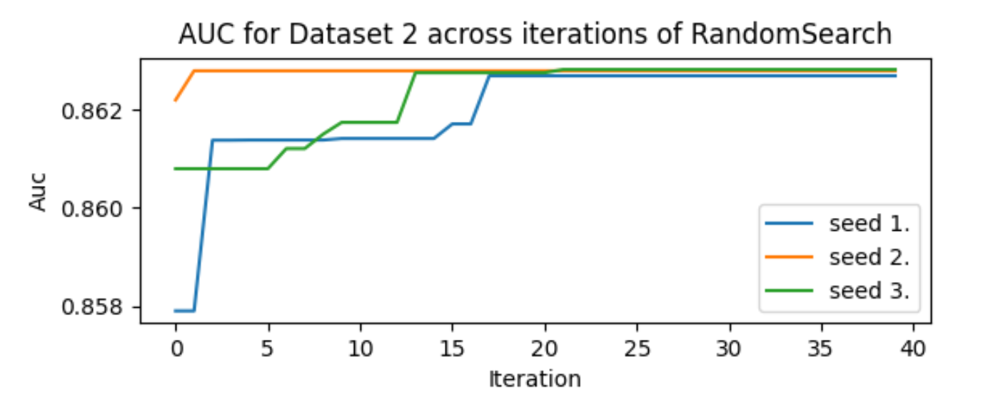
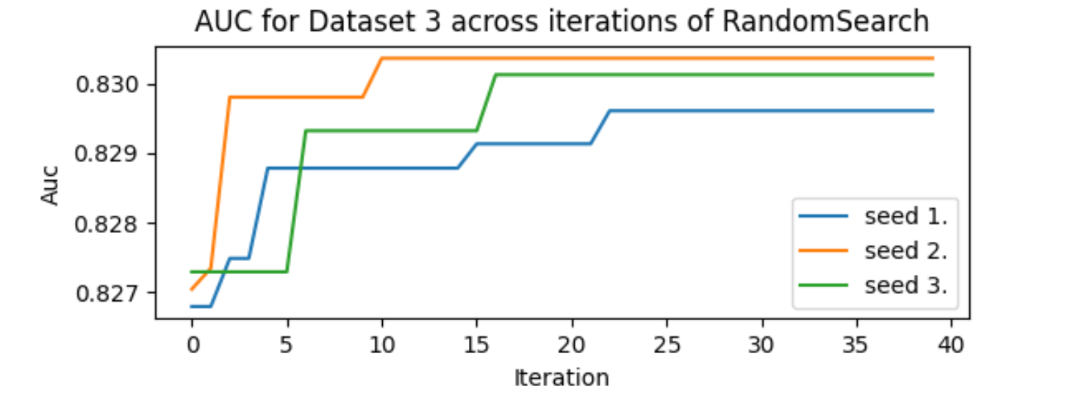
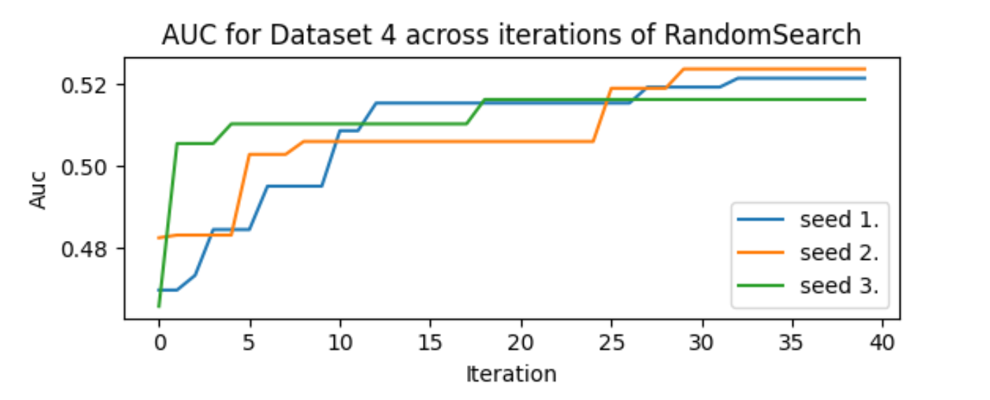
Random Forest
Stability across iterations:
Notes:
Szybko

Slide 18
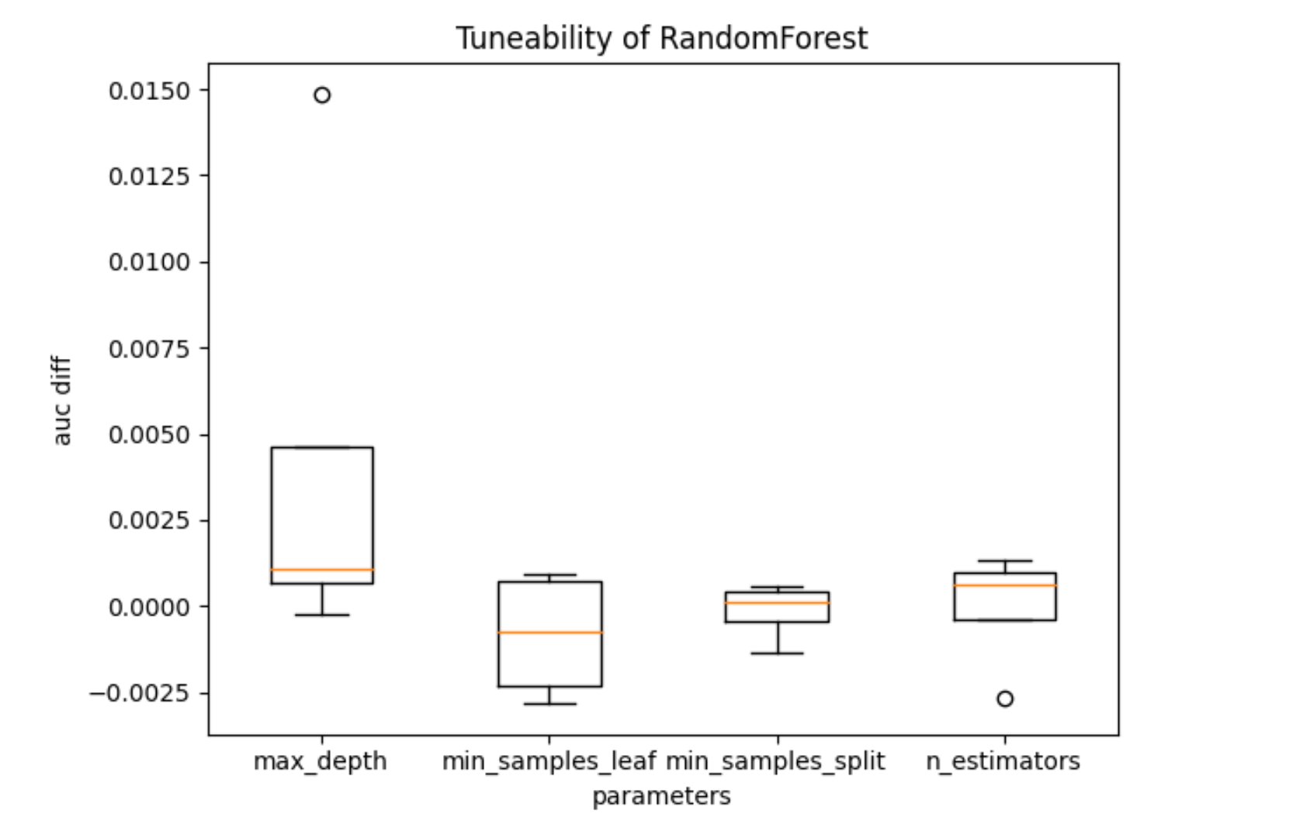
Random Forest
Hyperparameters Tunability:
Notes:
Szybko

Slide 19
XGBoost
Hyperparameters range:
n_estimators: (50, 200)
max_depth: (3, 10)
learning_rate: (0.001, 0.02)
Notes:
Szybko

Slide 20
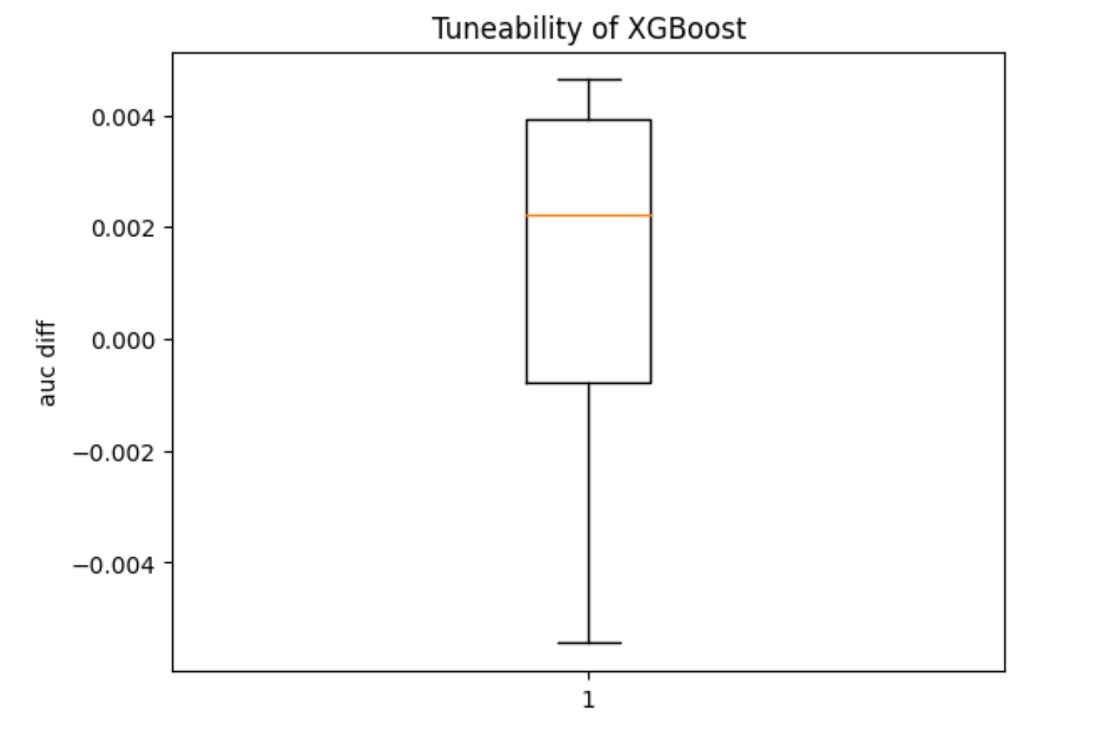
XGBoost
Algorithm Tunability:
Notes:
Szybko

Slide 21
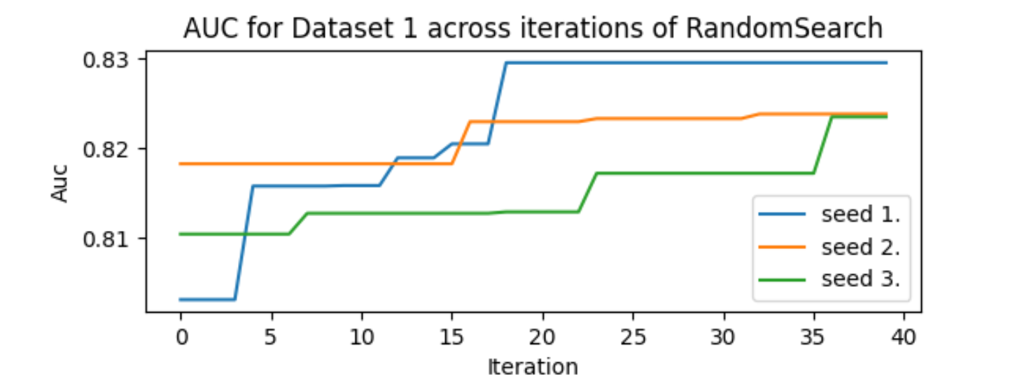
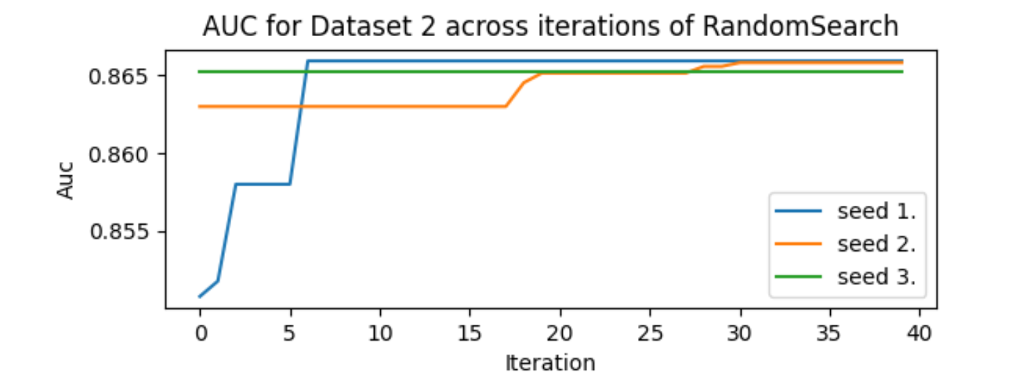
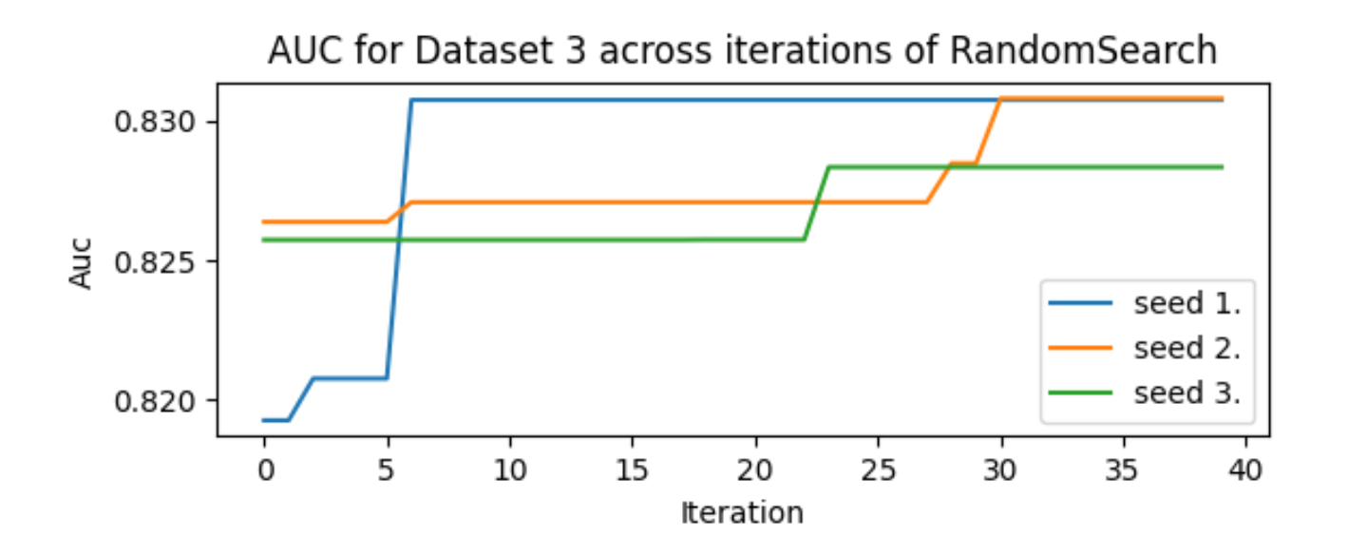
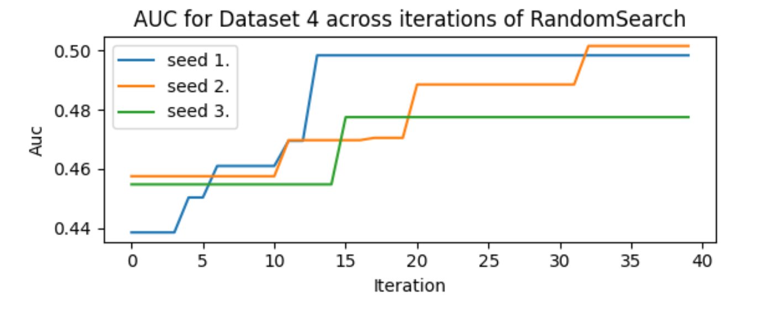
XGBoost
Stability across iterations:
Notes:
Szybko

Slide 22
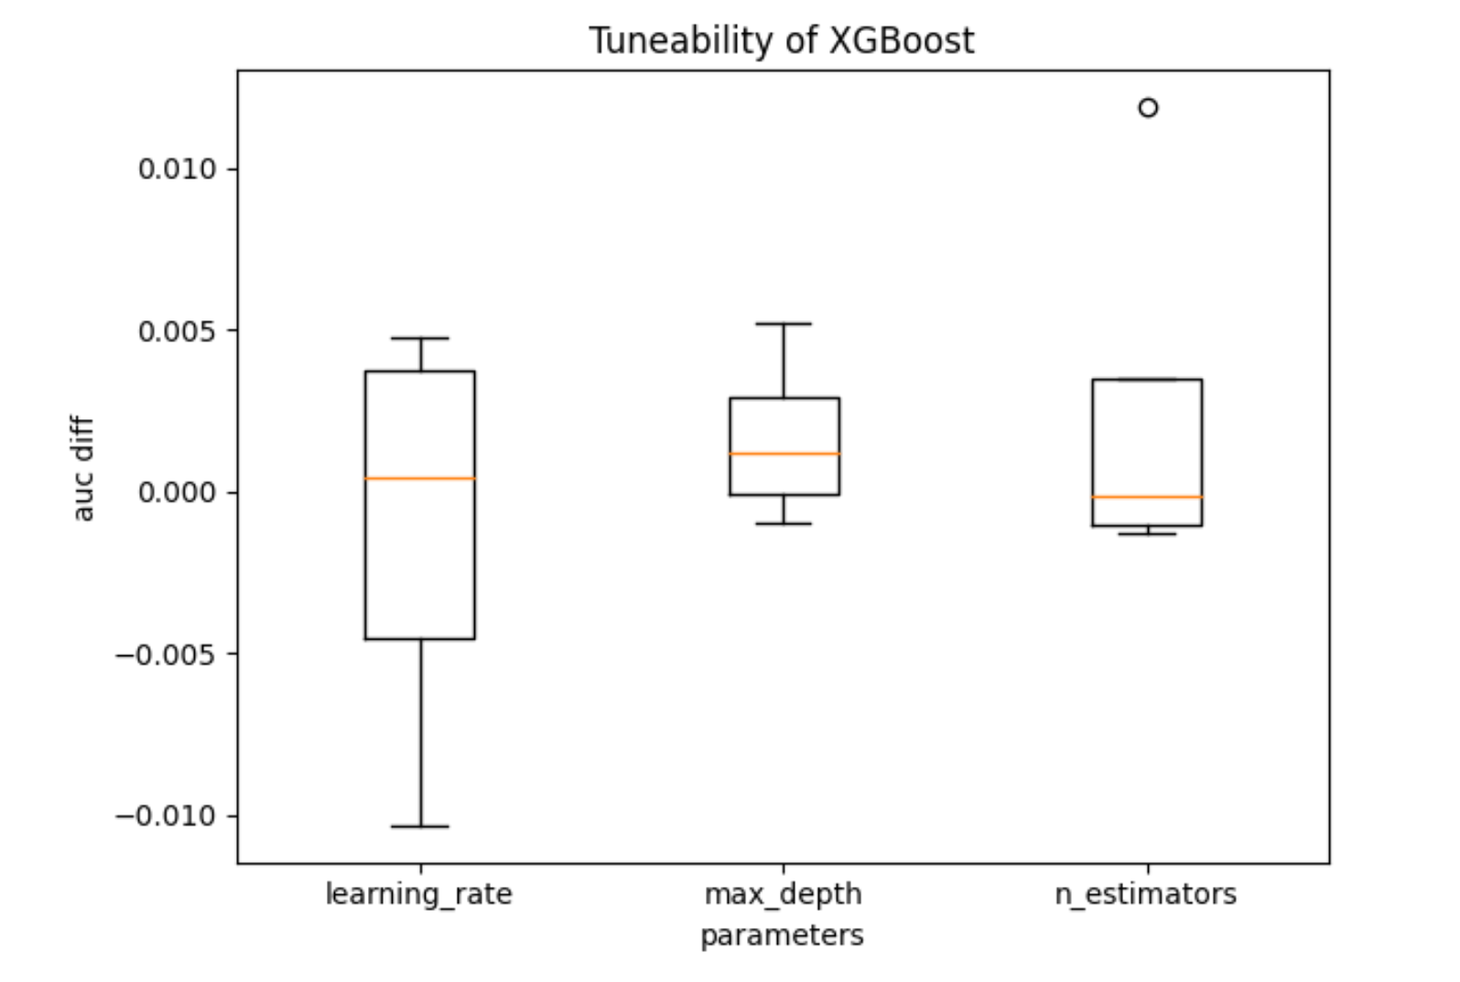
XGBoost
Hyperparameters Tunability:
Notes:
Szybko

Slide 23
LightGBM
Hyperparameters range:
n_estimators: (20, 300)
max_depth: (3, 10)
learning_rate: (0.01, 0.3)
num_leaves: (10, 100)
Notes:
Szybko

Slide 24
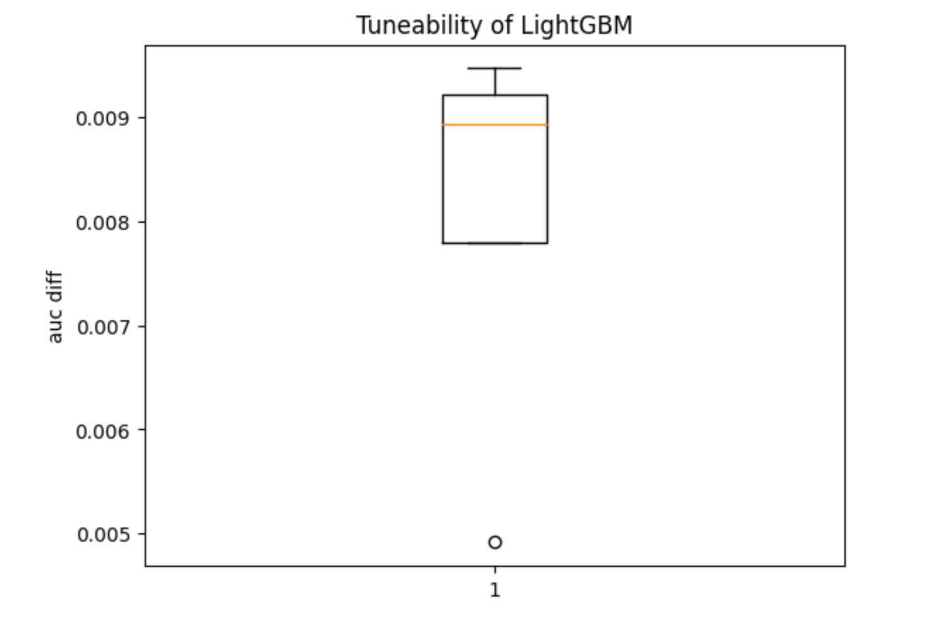
LightGBM
Algorithm Tunability:
Notes:
Szybko

Slide 25
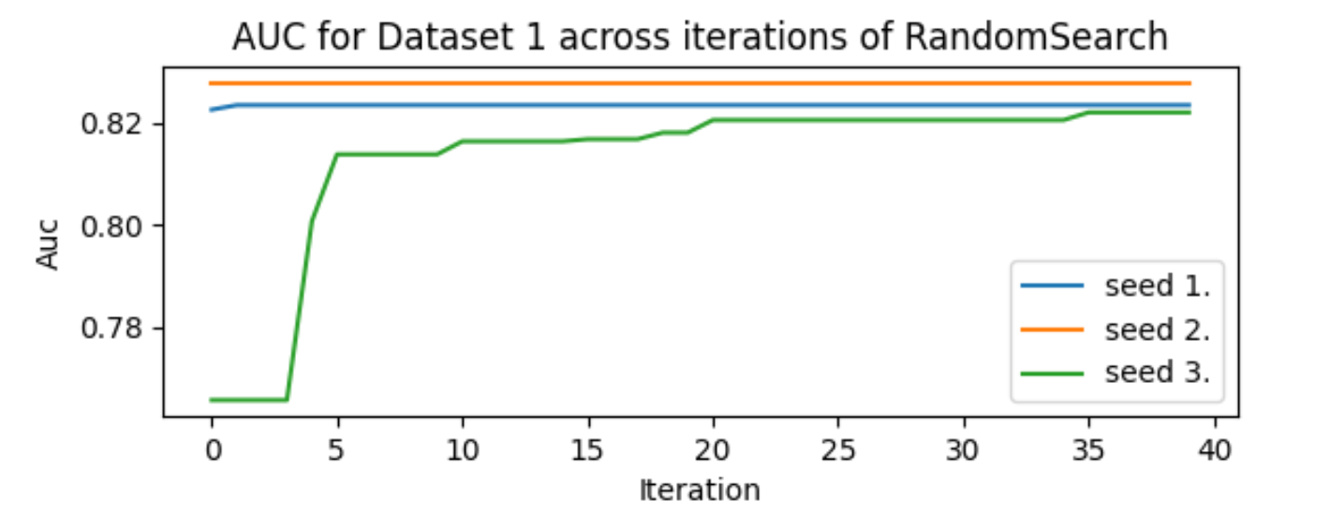
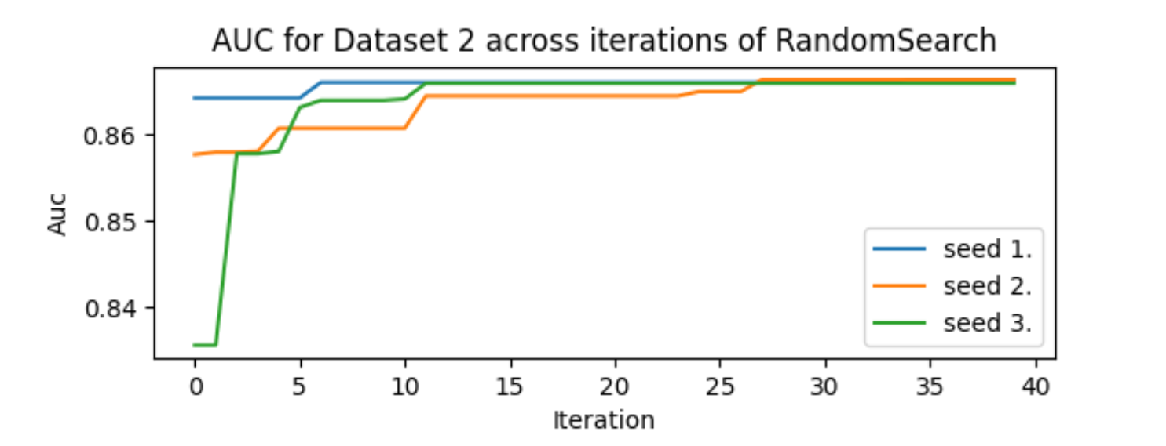
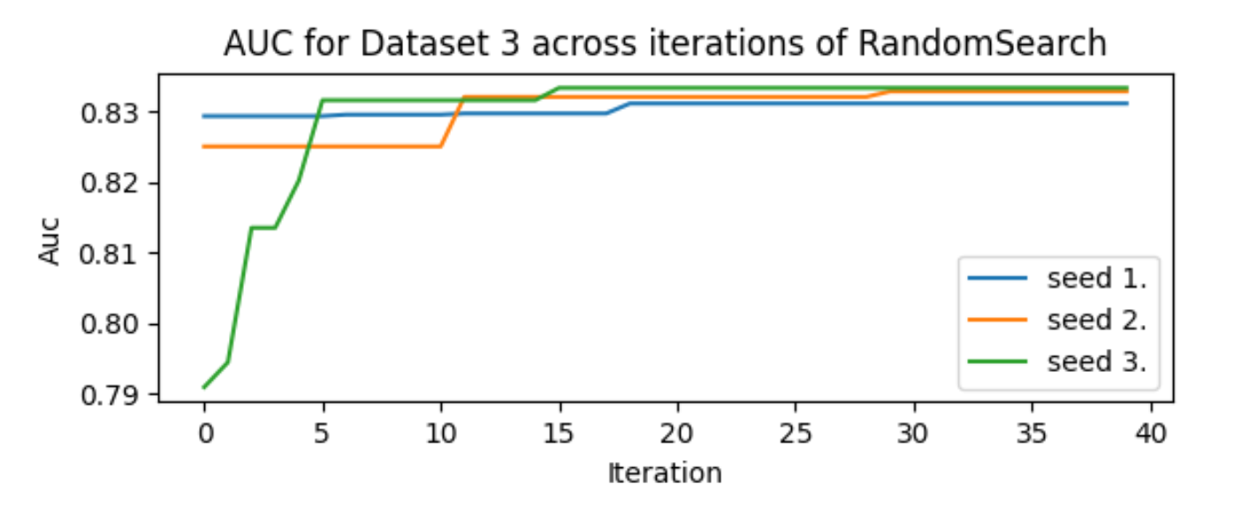
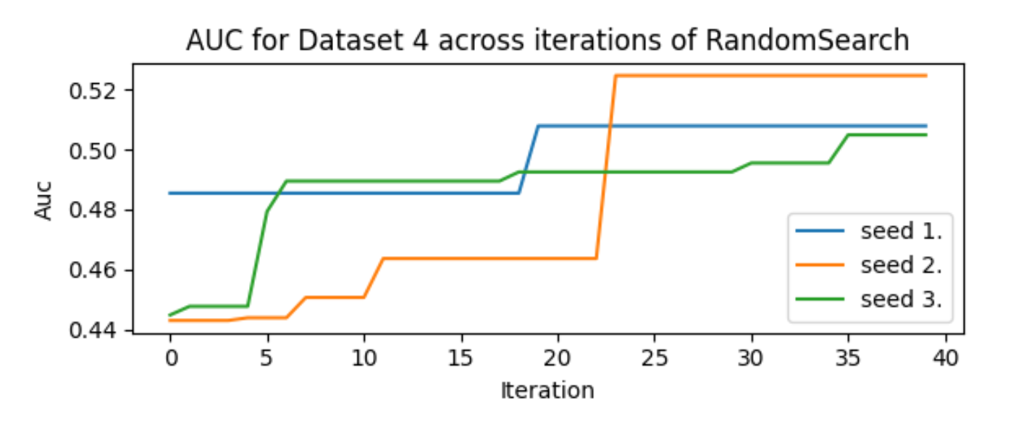
LightGBM
Stability across iterations:
Notes:
Szybko

Slide 26
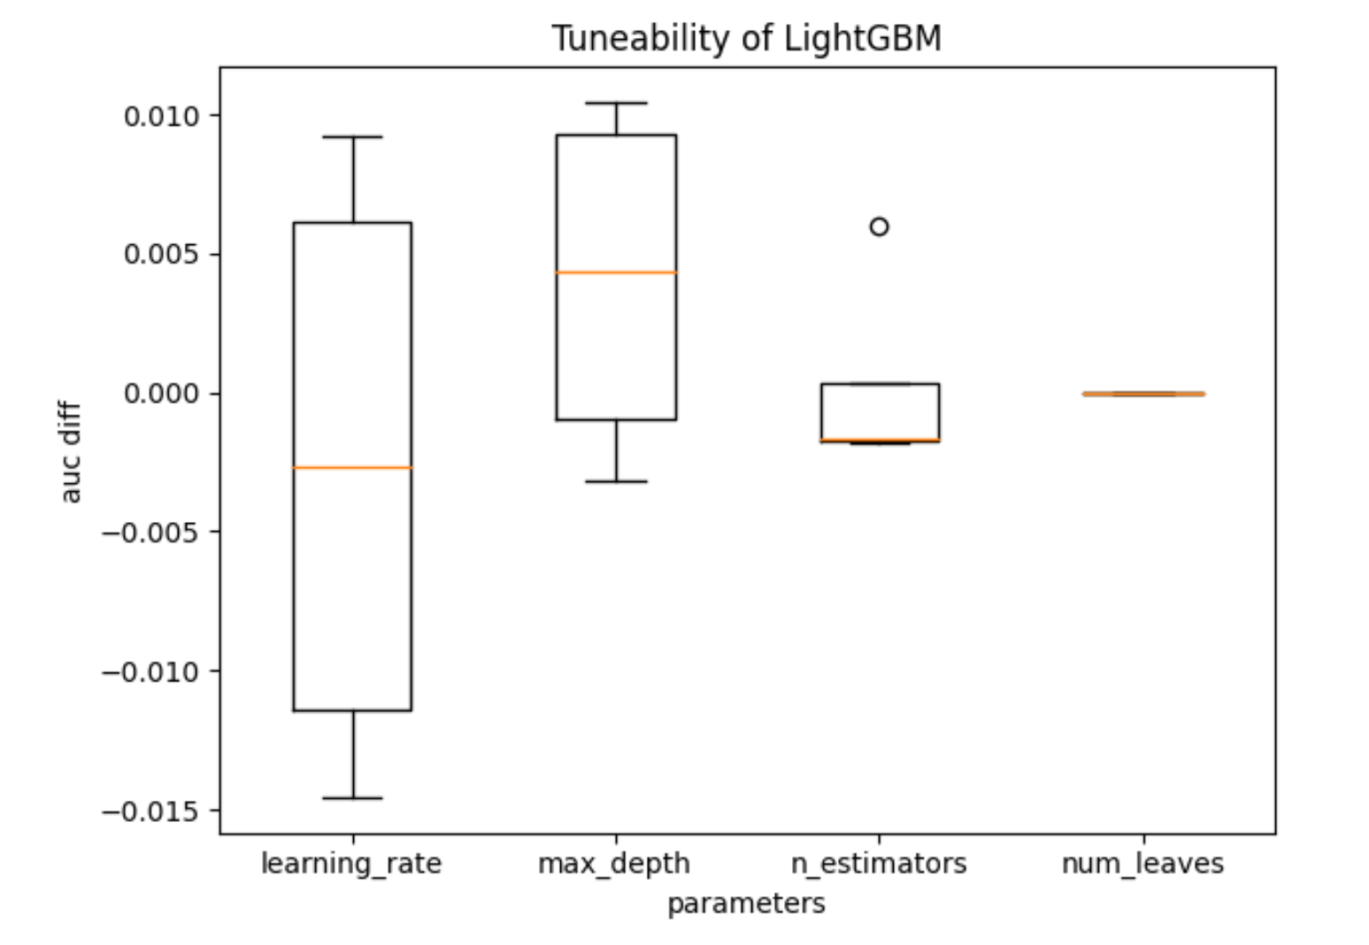
LightGBM
Hyperparameters Tunability:
Notes:
Szybko

Slide 27
04
Bayes Optimization

Slide 28
Random Forest
Hyperparameters range:
n_estimators: (50, 200)
max_depth: (5, 20)
min_samples_split: (2, 10)
min_samples_leaf: (2, 8)
Notes:
Szybko

Slide 29
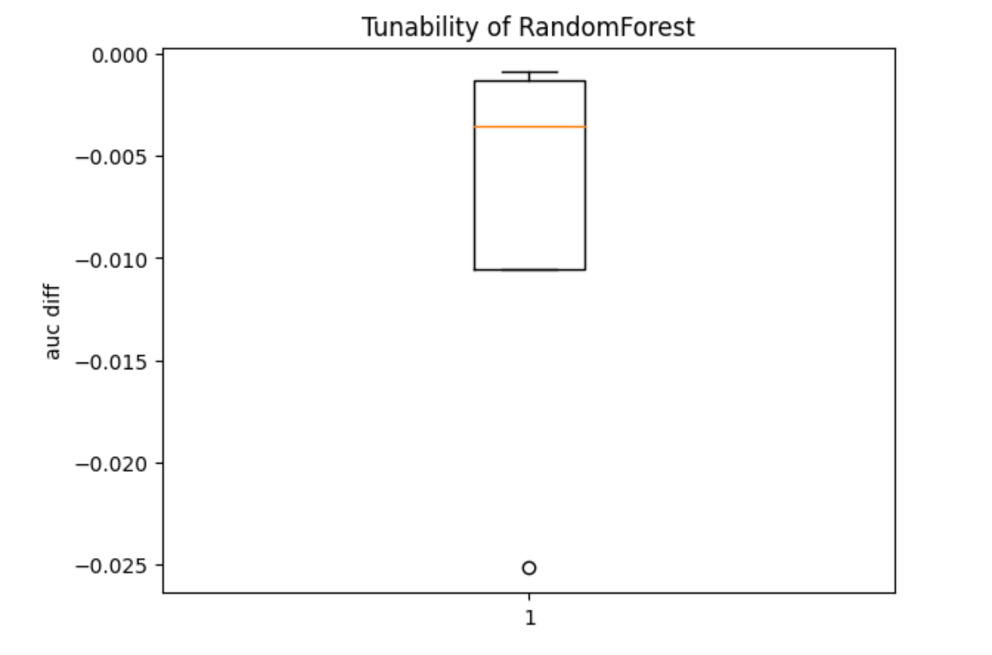
Random Forest
Algorithm Tunability:
Notes:
Szybko

Slide 30
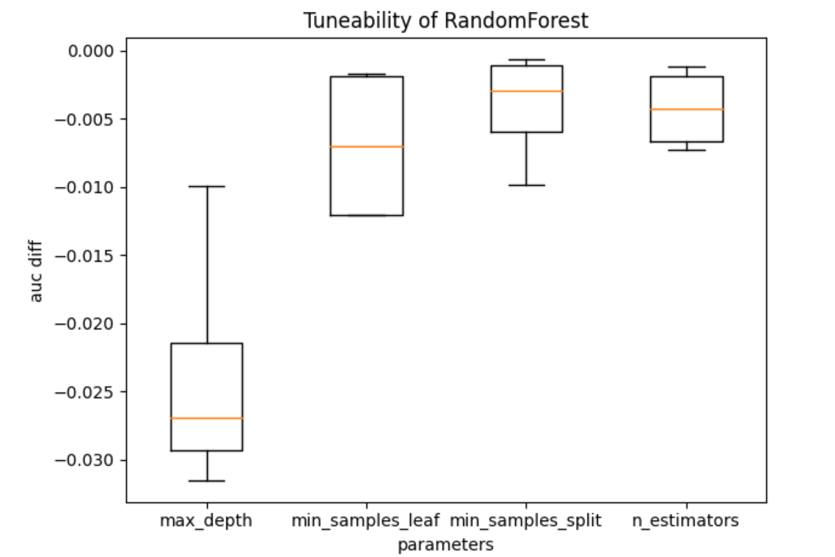
Random Forest
Hyperparameters Tunability:
Notes:
Szybko

Slide 31
XGBoost
Hyperparameters range:
n_estimators: (50, 200)
max_depth: (3, 10)
learning_rate: (0.001, 0.02)
Notes:
Szybko

Slide 32
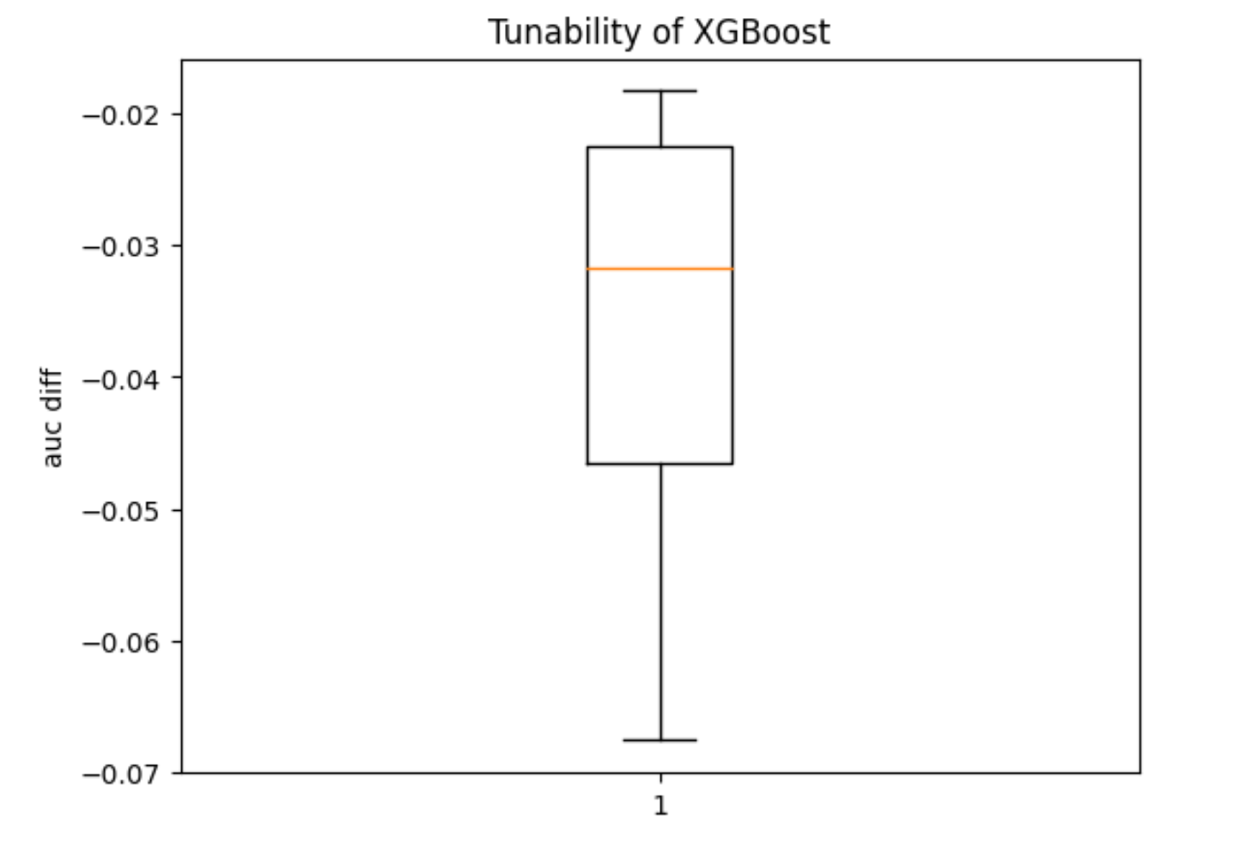
XGBoost
Algorithm Tunability:
Notes:
Szybko

Slide 33
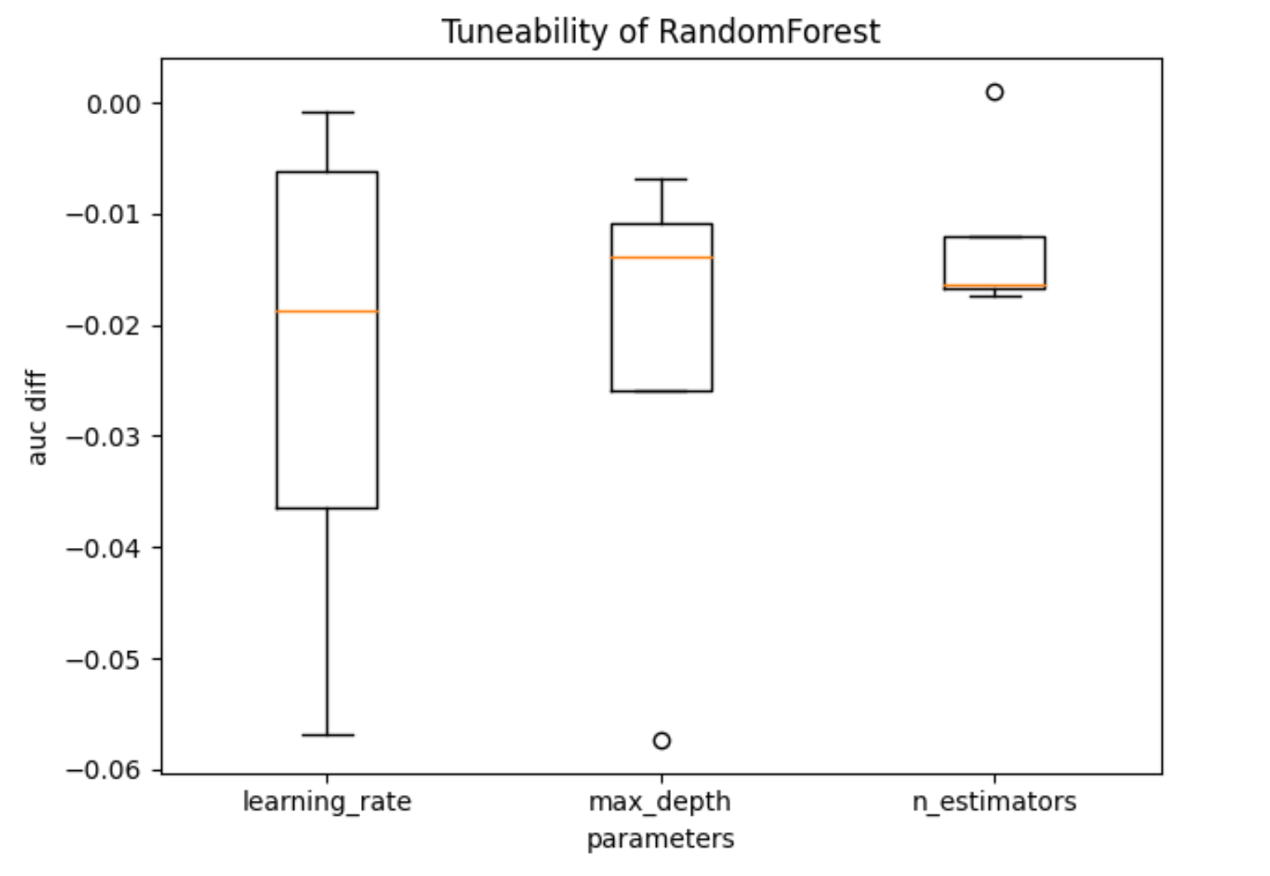
XGBoost
Hyperparameters Tunability:
Notes:
Szybko

Slide 34
LightGBM
Hyperparameters range:
n_estimators: (20, 300)
max_depth: (3, 10)
learning_rate: (0.01, 0.3)
num_leaves: (10, 100)
Notes:
Szybko

Slide 35
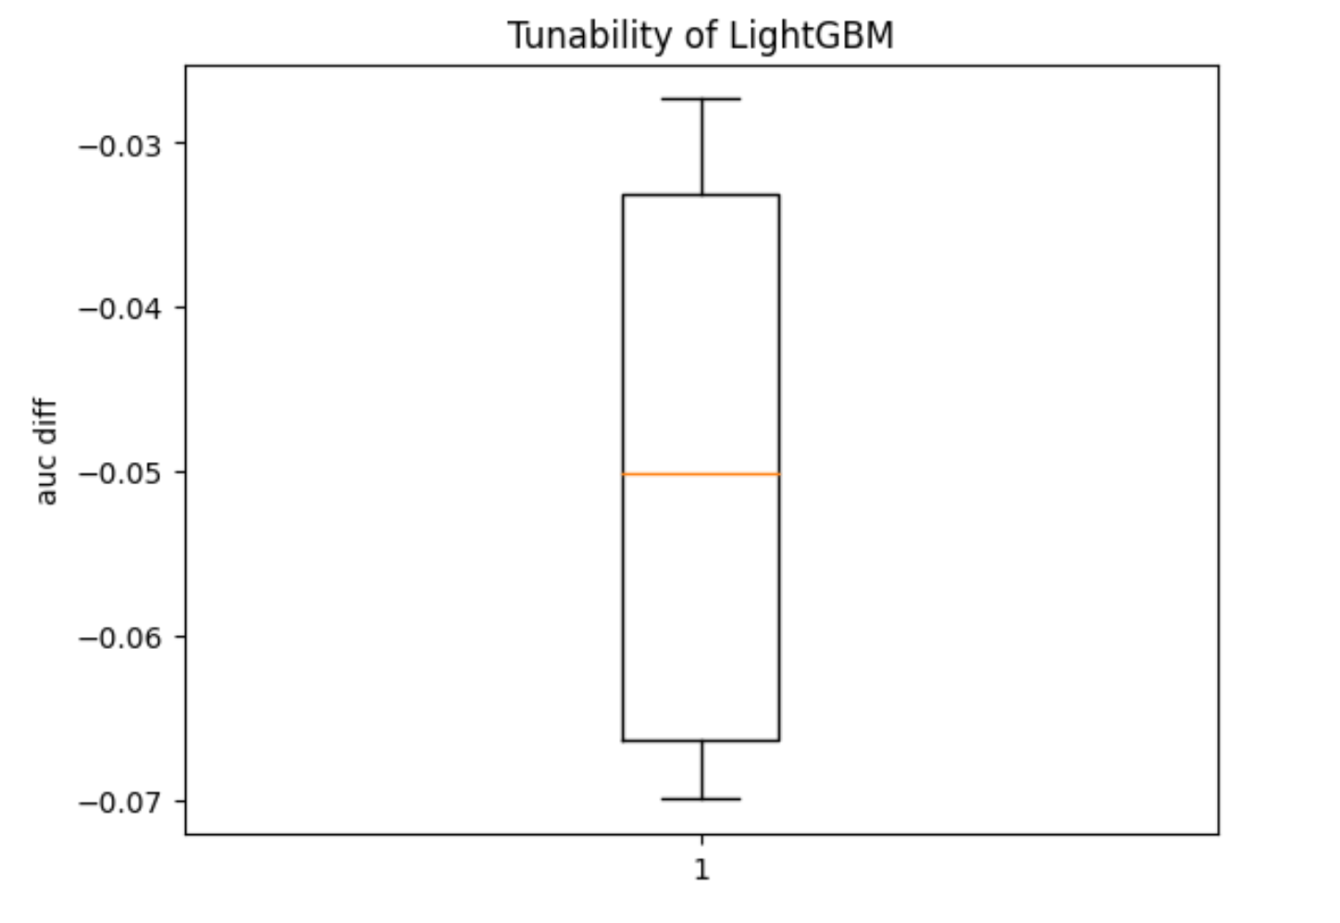
LightGBM
Algorithm Tunability:
Notes:
Szybko

Slide 36
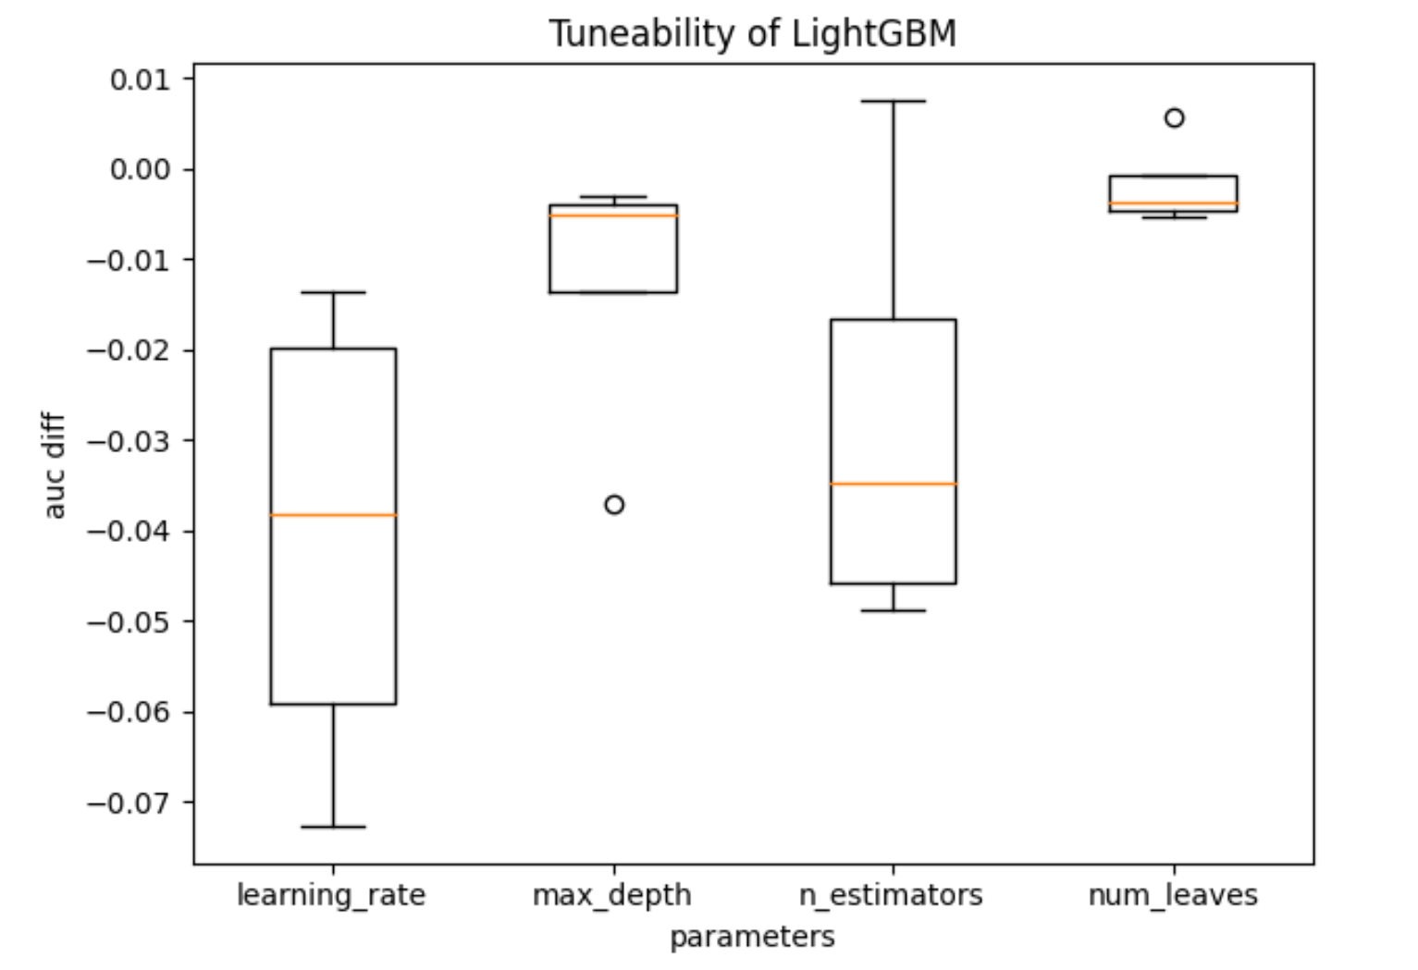
LightGBM
Hyperparameters Tunability:
Notes:
Szybko

Slide 37
Podsumowanie
Random Forest XGBoost LightGBM

Slide 38
Podsumowanie
Random Forest XGBoost LightGBM
Grid Search Random Search Bayes Optimization

Slide 39
Dziękujemy za uwagę!

